Slide 1
Cipher Master: Playfair and Vigenère Encryption and Decryption

Slide 2


Green University of Bangladesh
Department of Computer Science and Engineering
Semester: Fall 2024, BSc in CSE(DAY)
Section: 213 221 D4
Cipher Master: Playfair and Vigenère
Encryption and Decryption
Submitted by, Md Opu Mia 213902036
Md Rabby Khan 213902037
Md.Sabbir Hasan 213902112 Dept. of CSE Green University of Bangladesh
Submitted to, Md. Sabbir Hosen Mamun Lecturer
Dept. of CSE Green University of Bangladesh

Slide 3
Contents
Introduction
Objective
Algorithms
Tools and Libraries
Design and Implementation
Results and Analysis
Challenges and Solutions
The Future Scope

Slide 4
Introduction to Cipher Master
Cipher Master is a web-based application designed to demonstrate the Playfair and Vigenère ciphers for encryption and decryption. It provides an interactive platform where users can visualize and understand these classical cryptographic techniques in real-time. The project aims to educate users about cryptography while offering a practical encryption solution for basic data security.

Slide 5
Objective
Implement Playfair and Vigenère ciphers for encryption and decryption.
Handle edge cases like duplicates and special characters.
Create a user-friendly and interactive interface.
Provide real-time encryption/decryption visualization.
Ensure cross-platform compatibility.
Optimize for performance and responsiveness.

Slide 6
Algorithms
Playfair Cipher - Message Preparation and Encryption
Generation:
Choose a keyword.
Remove duplicate letters.
Fill the 5x5 grid with the remaining alphabet letters (treat I/J as one letter).
Grid Formation:
Create a 5x5 grid.
Fill the grid with the keyword letters first.
Follow the remaining unused letters of the alphabet.

Slide 7
Algorithms
Playfair Cipher - Message Preparation and Encryption
Message Preparation:
Divide the plaintext into digraphs (pairs of letters).
Insert a filler letter (e.g., 'Z') between identical letters.
Add a filler letter if the plaintext has an odd number of letters.

Slide 8
Algorithms
Playfair Cipher - Message Preparation and Encryption
Letter Transformation (Encryption):
Same Row: Replace each letter with the letter to its right (wrap around if needed).
Same Column: Replace each letter with the letter below it (wrap around if needed).
Different Row and Column: Replace each letter with the letter in the same row and the other letter's column.

Slide 9
Algorithms
Playfair Cipher - Decryption Algorithm
Key Reconstruction:
Recreate the 5x5 grid using the same keyword.
Ciphertext Preparation:
Break the ciphertext into digraphs (pairs of letters).

Slide 10
Algorithms
Playfair Cipher - Decryption Algorithm
Letter Transformation (Decryption):
Same Row: Replace each letter with the letter to its left (wrap around if needed).
Same Column: Replace each letter with the letter above it (wrap around if needed).
Different Row and Column: Replace each letter with the letter in the same row and the other letter's column.

Slide 11
Algorithms
Vigenere Cipher - Encryption Algorithm
Key Selection:
Choose a keyword.
Repeat the keyword to match the length of the plaintext.
Encryption Process:
Convert plaintext and keyword into numeric values (A=0, B=1, C=2, ..., Z=25).
Use the formula: Ei = (Pi + Ki) mod 26.
Locate the corresponding encrypted letter using the Vigenère table (26x26 grid).

Slide 12
Algorithms
Vigenere Cipher - Decryption Algorithm
Decryption Process:
Repeat the key to match the length of the ciphertext.
Use the formula: Di = (Ci − Ki) mod 26.
Convert the numeric result back into letters to retrieve the plaintext.

Slide 13
Tools and Libraries
Frontend Tools: HTML, CSS, and JavaScript for structure, styling, and functionality.
Libraries: Bootstrap for responsive design and Lodash for efficient data manipulation.
Development Tools: Visual Studio Code and Browser DevTools for coding and debugging.
Testing Tools: Unit testing and cross-browser testing to ensure functionality and compatibility.
Version Control: Git and GitHub for managing and sharing source code.
Deployment: Hosted on a web server for seamless access across platforms.

Slide 14
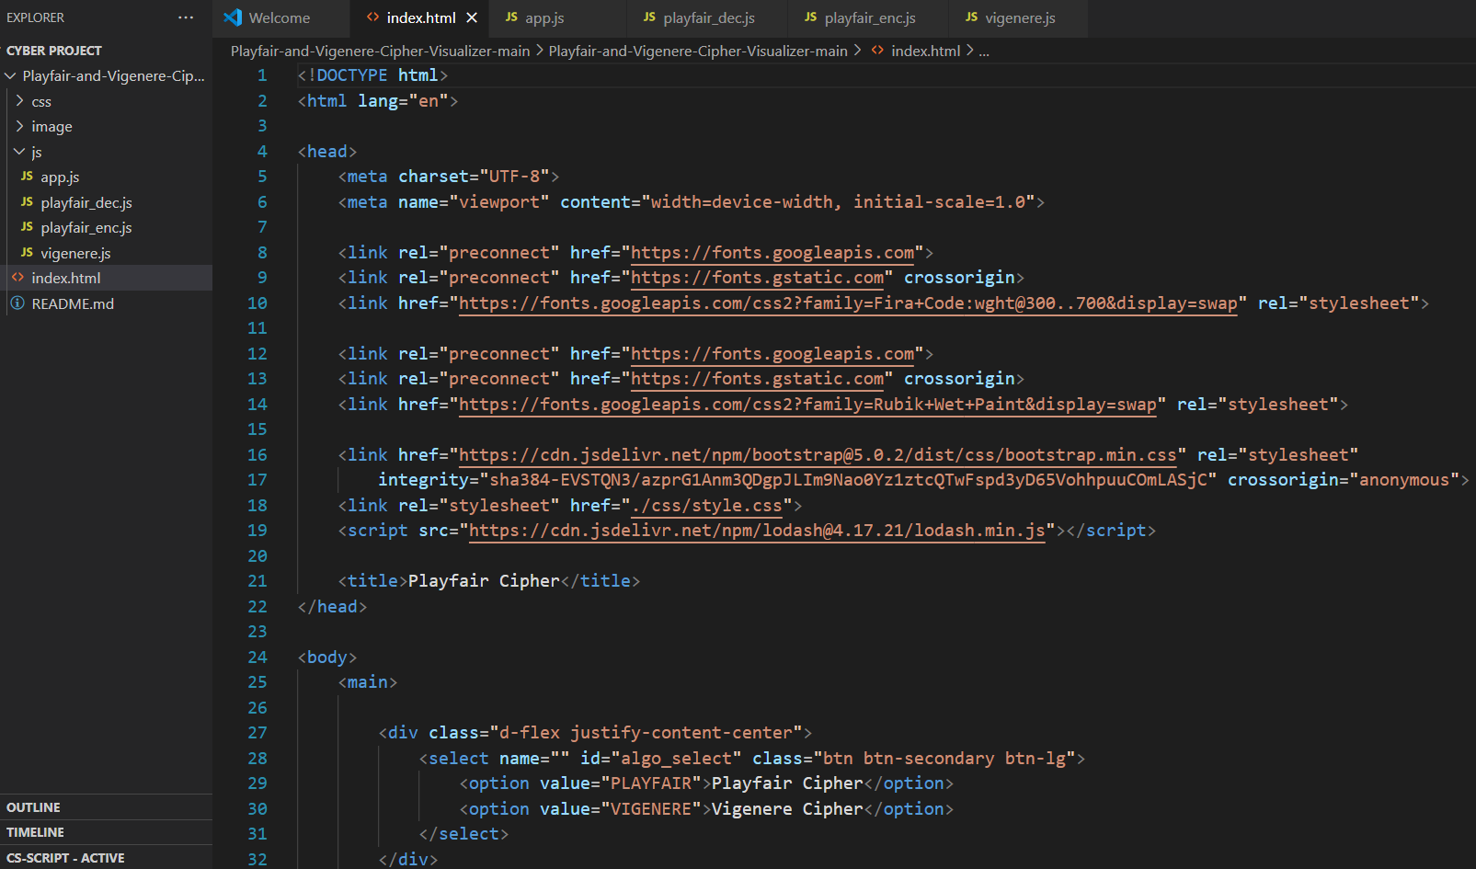
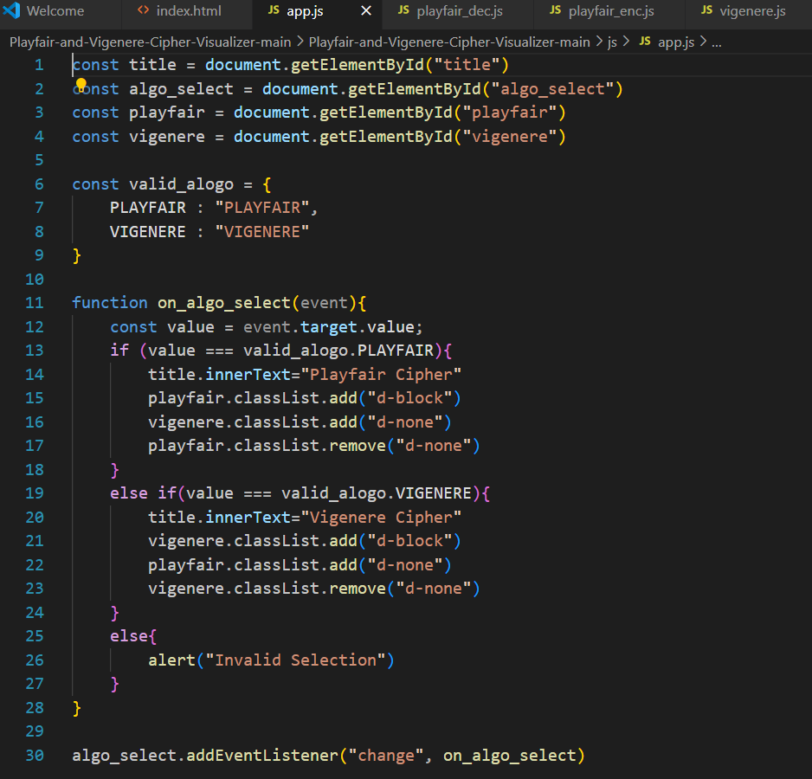
Design and Implementation

Slide 15
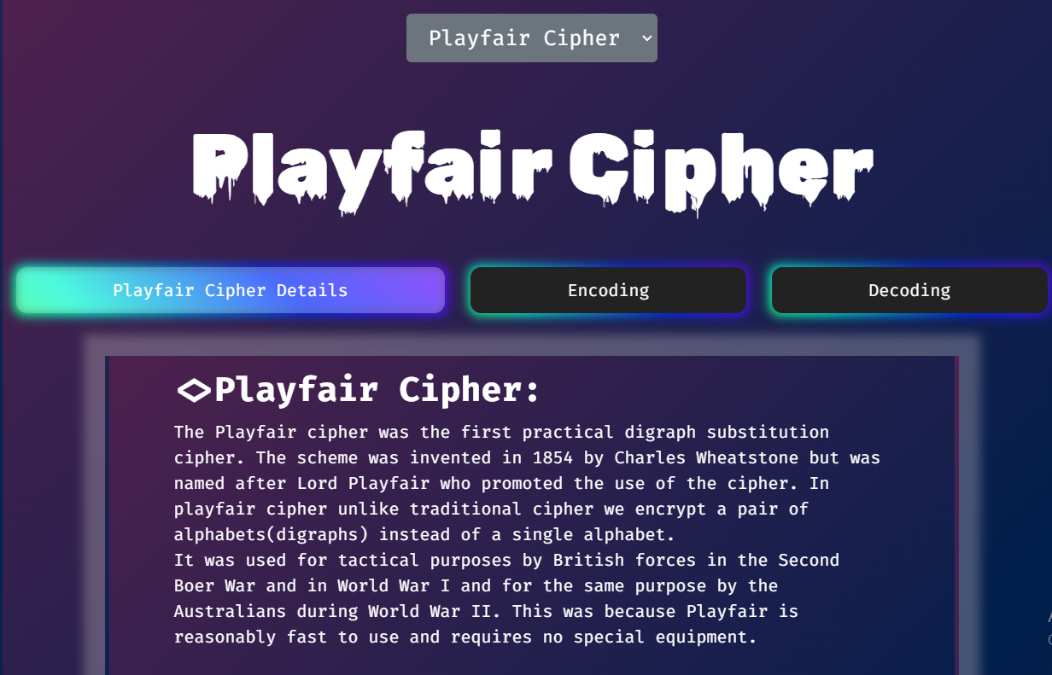
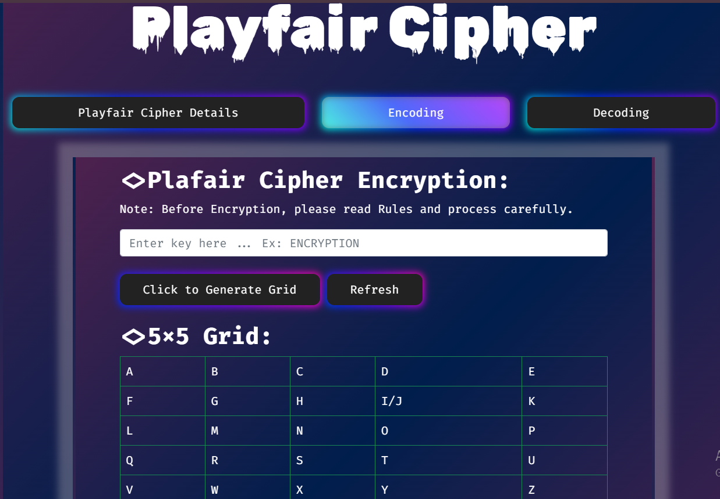
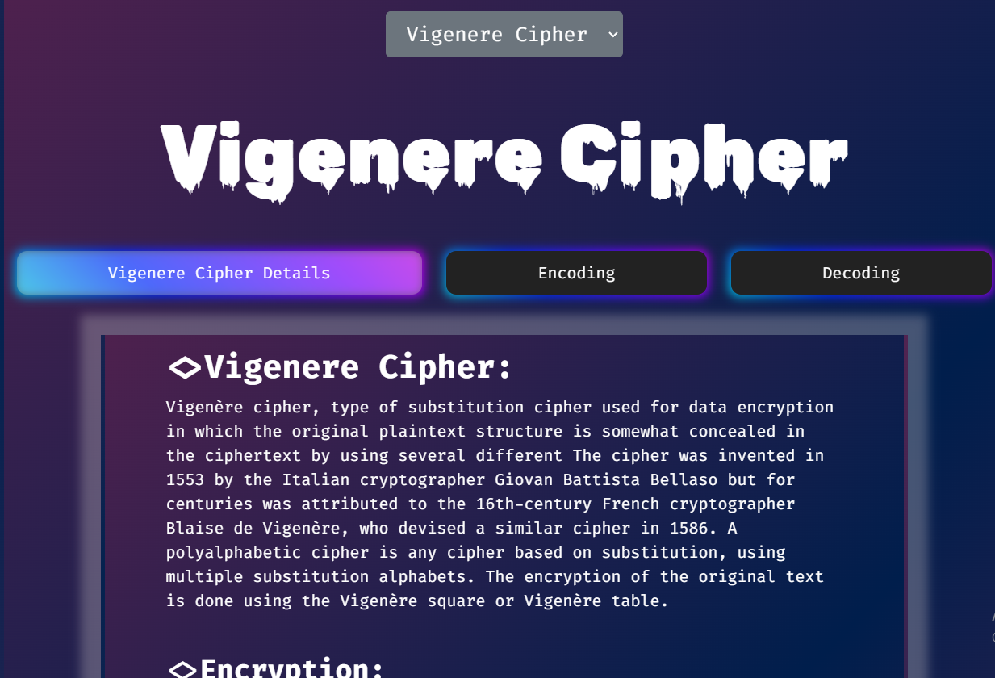
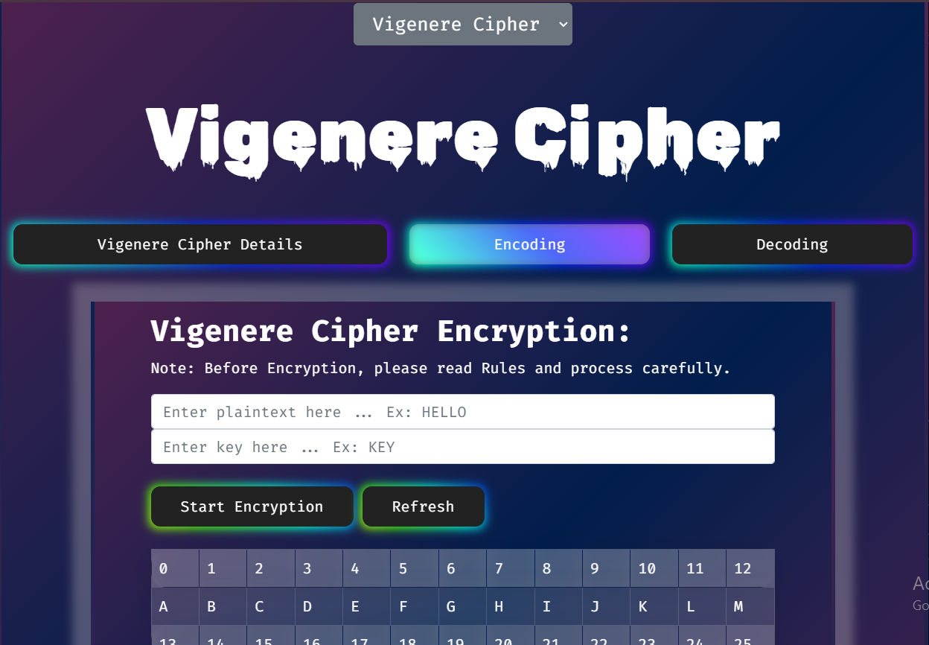

Slide 16
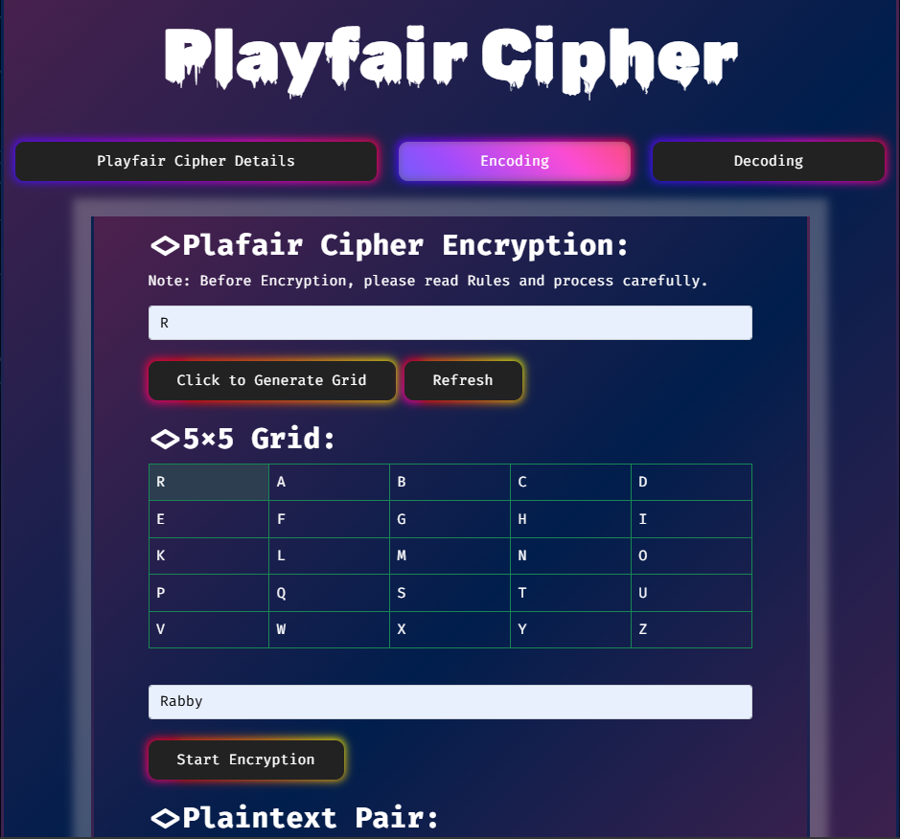
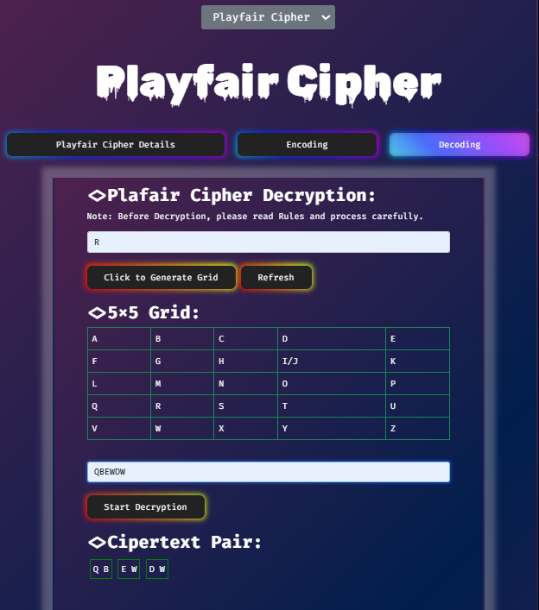
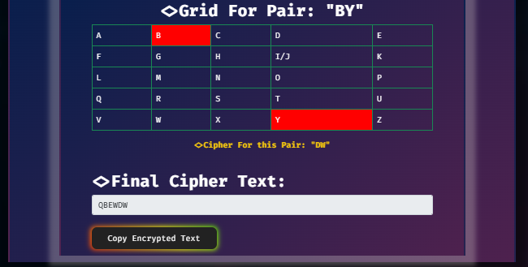
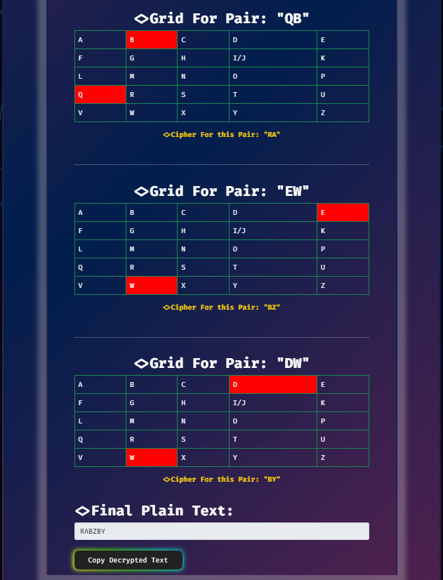

Slide 17
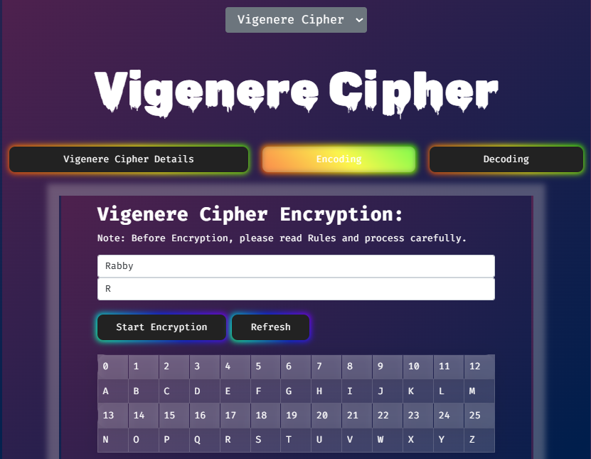
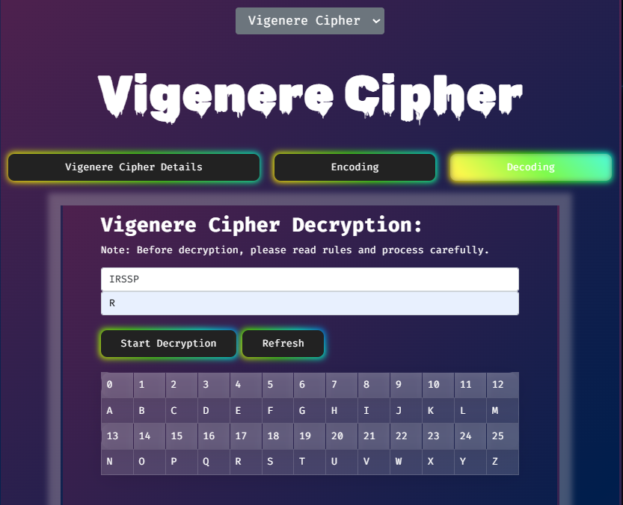
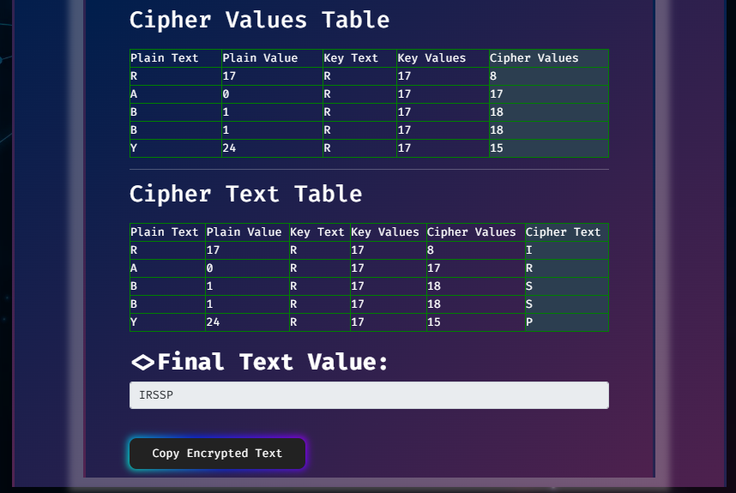
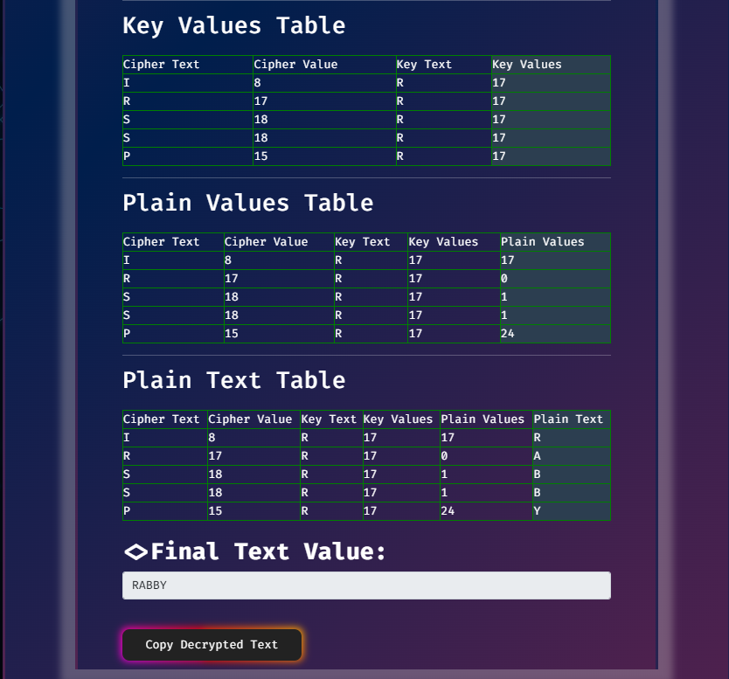

Slide 18
Results and Analysis
Demonstration
Real-time encryption and decryption using Playfair and Vigenère ciphers.
Dynamic 5x5 grid generation and live feedback for user inputs.
Educational Value
Simplifies complex cryptographic concepts with interactive visualizations.
Helps users understand encryption rules and weaknesses of classical ciphers.
Strengths
Accurate implementation of algorithms.
Intuitive UI with real-time updates.
Effective for learning and basic encryption.
Limitations
Vulnerable to cryptanalysis (e.g., frequency analysis, key repetition).
Limited scalability for larger inputs or modern encryption needs.

Slide 19
Challenges and Solutions
Complex Engineering Problems
Implementing Playfair and Vigenère algorithms with edge-case handling.
Ensuring dynamic grid generation and real-time feedback.
Balancing Goals
Historical Accuracy: Preserving cipher rules while adapting them for usability.
Usability: Designing an intuitive interface without oversimplifying cryptographic principles.
Ensuring Quality
Accuracy: Rigorous testing to validate encryption and decryption logic.
Performance: Optimizing algorithms for real-time interaction.
Interactivity: Creating responsive visuals for educational value and user engagement.

Slide 20
Future Scope
Advanced Algorithms: Add modern ciphers like AES, RSA, and ECC.
UI Enhancement: Improve interactivity and multi-language support.
Large Input Support: Optimize for bulk data encryption.
Mobile App: Develop for smartphones and tablets.
Cryptanalysis Tools: Add features like frequency analysis.

Slide 21
Any Question?

Slide 22
Thank You So Much !

